Slide 1


Latvia–France Business Forum
DECARBONIZATION OF THE ECONOMY
Ministry of climate and energy of latvia
Riga | 21.05.2024.

Slide 2



Energy sector in Latvia Objectives
Energy independence and export
Effective use of our resources
Market economy and price signals

Slide 3
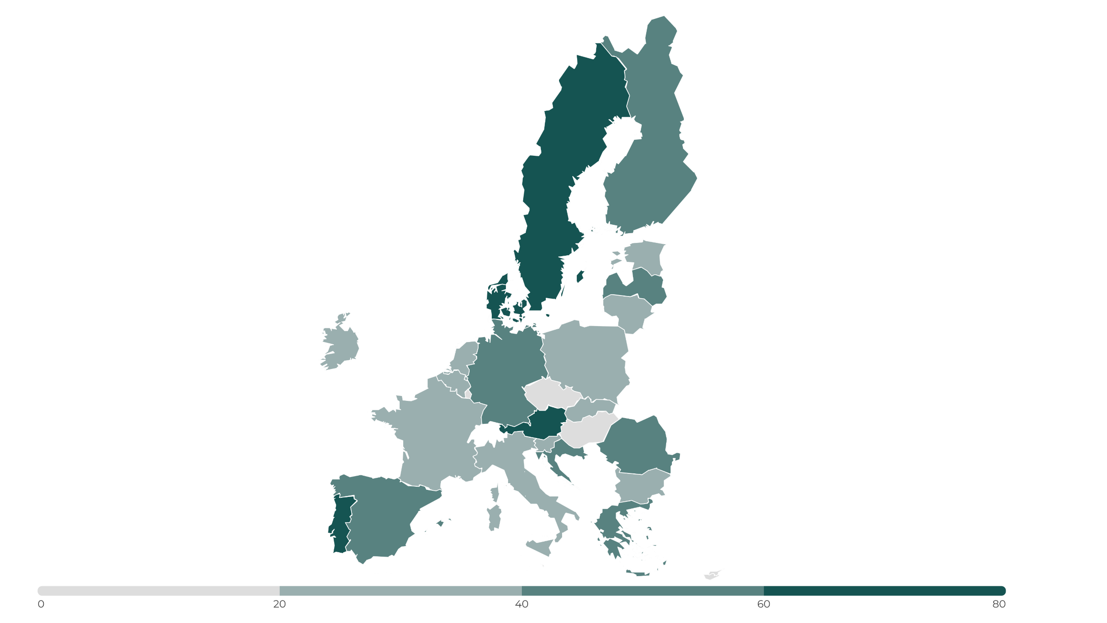
Share of renewable electricity in Europe
83%
48%
29%
Average Share in Europe
41%
77%
53%
26%
37%
40%
21%
48%
29%
15%
75%
23%
27%
15%
37%
44%
56%
20%
61%
51%
37%
42%
Source: 2022, Eurostat

Slide 4
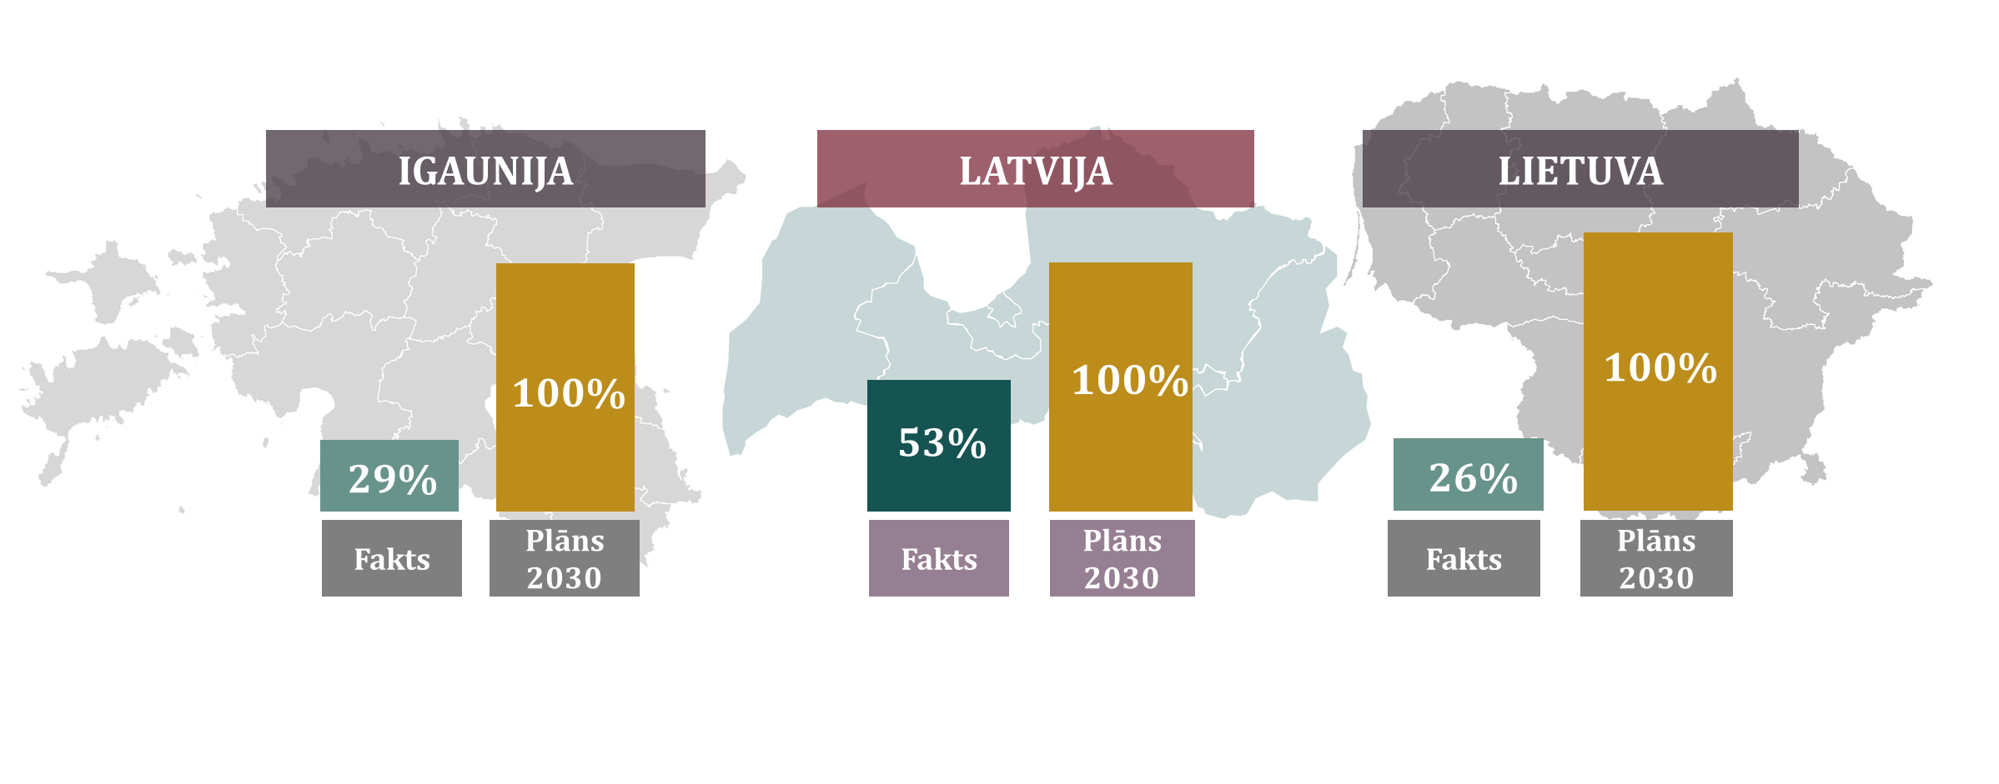
RES in Final electricity consumption
ESTONIA
LATVIA
LITHUANIA
2022
2030
2022
2030
2022
2030

Slide 5
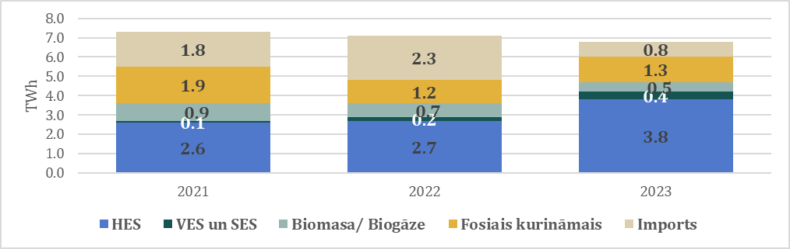
How much res elelctricity do we need?
HPP
WPP & PV
Biomass & biogas
Fossil fuels
Import
To achieve 100% RES in electricity we need
around 1.5-2 GW wind energy.

Slide 6
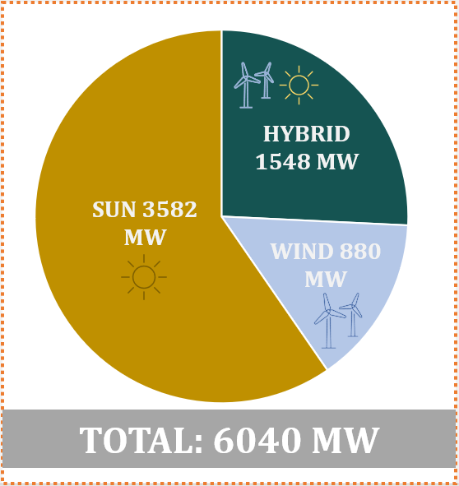
Installed Wind energy capacities
Installed wind energy capacities in 2023 in the Baltic States (MW)
Reserved transmission grid capacities in Latvia in 2024 (MW)

Slide 7


WE create the future of LV energy sector!!

