Slide 2
A STRONG HISTORY
1945
2015
2006
1971
2014
KNDS
Group consolidation under DEFA (Direction des Etudes et Fabrication d’Armements)
Nexter
Acquisition of Mecar & Simmel Difesa
2020
2023
1690
Creation of the G.I.A.T
(Groupement industriel des Armements Terrestres
New governance
Rebranding
GIAT Industries
1990
Establishment of the first weapons factories (Tulle)
This document is the property of Nexter. The information it contains cannot be used, reproduced or disclosed without prior written approval from the issuing authority.
1764
1947
1992
2006
Gribeauval
CANNON
AMX 13
LECLERC TANK
VBCI
JAGUAR & GRIFFON
2018/2020
1976
1897
2004
2013
AMX 10 RC
75mm CANNON
CAESAR®
Artillery system
TITUS®
SERVAL

Slide 3
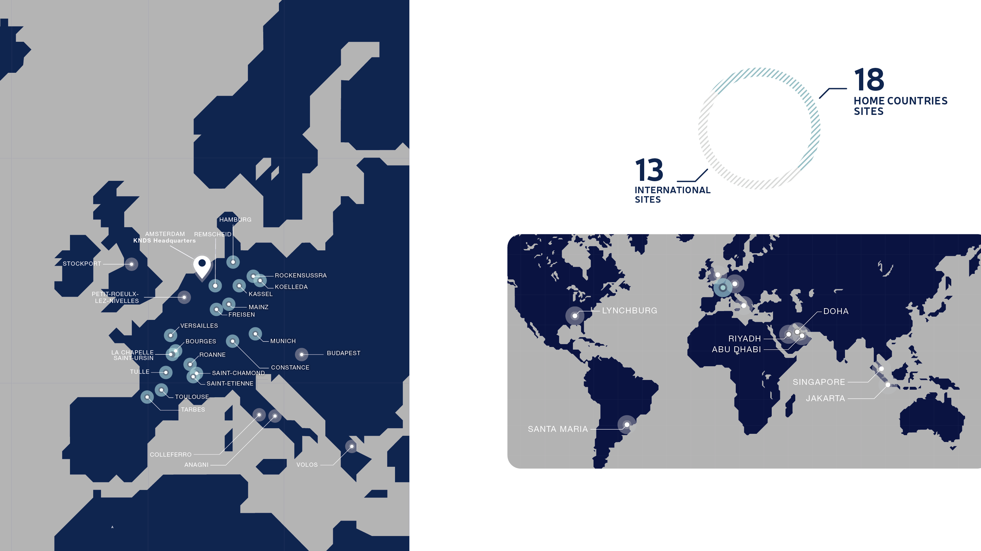
KNDS A EUROPEAN LEADER
KNDS AN INTERNATIONAL PRESENCE

Slide 4
KNDS France
EUROPEAN
LEADER
in land defense
ARCHITECT
AND SYSTEMS INTEGRATOR
of armored vehicles and artillery systems
STRATEGIC
KNOW-HOW
in medium and large caliber weapons and ammunition
This document is the property of Nexter. The information it contains cannot be used, reproduced or disclosed without prior written approval from the issuing authority.
Combined design, development, manufacturing, integration and support and services capabilities that are unique in the land defense sector in France.
KNDS France, leader of the French industry for MGCS studies.

Slide 5
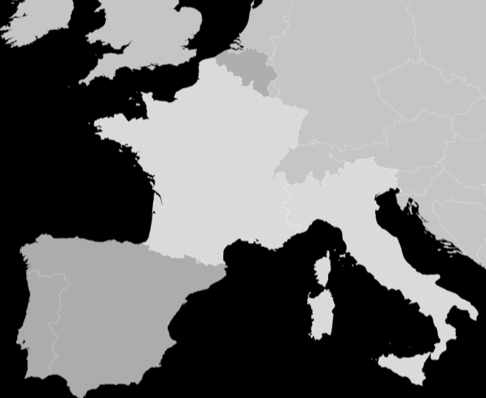
ASSETS
Petit-Roeulx-Lez-Nivelles
4 469
Versailles
Employees
Bourges
La Chapelle-Saint-Ursin
Roanne
Saint-Chamond
Tulle
Saint-Etienne
This document is the property of Nexter. The information it contains cannot be used, reproduced or disclosed without prior written approval from the issuing authority.
2 223
Toulouse
Tarbes
Colleferro
Suppliers, of which
1304 are SMEs
Anagni
12 sites France / Belgium / Italy
FACILITIES
INNOVATION
13%
2 800
of turnover invested in R&D
active patents in Nexter portfolio

Slide 6
KNDS France
PRODUCTS & SERVICES

Slide 7
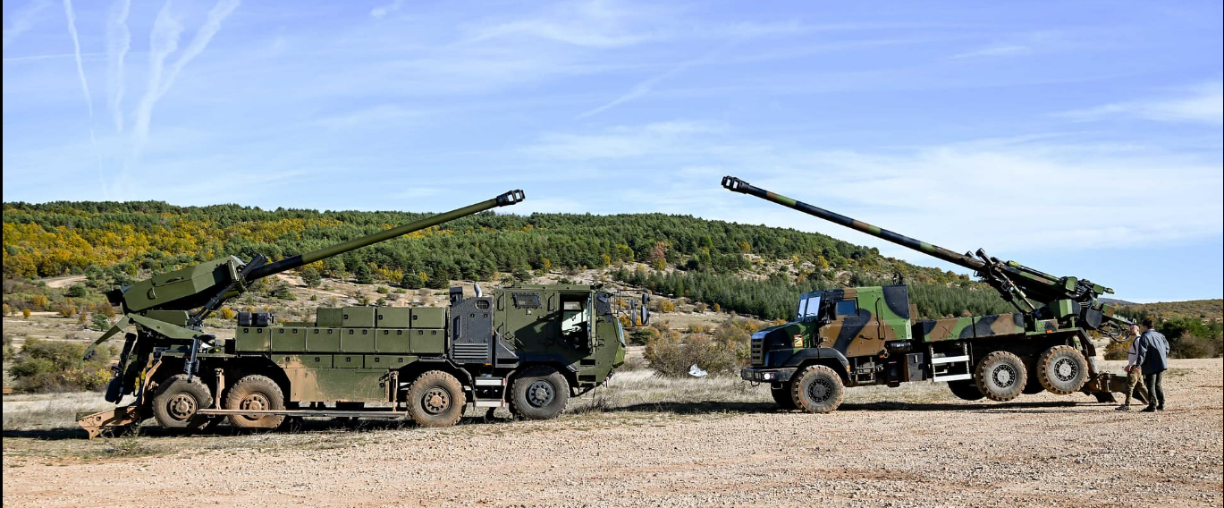

Slide 8
(SOME) CAESAR® BENEFITS
« Truly » combat proven solution (gun + FCS + ammunition range)
All terrains and climate areas from extreme cold to extreme hot
In service with Domestic Customer (France) → State Qualification (availability of test reports) / Operational know-how
Reliability : not only technical but also in terms of LCC figures and MTBF (Mean Time Between Failure)
The truck-mounted 155mm / 52 cal. reference : more than 500 units in service / on order → « CAESAR® User Club » established in 2023 (already 9 user countries) → increased pooling and sharing opportunities
The NATO self-propelled wheeled howitzer reference : France (109), Belgium (28), Lithuania (18), Czech Republic (62) → and soon many more

Slide 9
G2G OPPORTUNITY - BENEFITS
« Real G2G » → DGA acting as contracting authority / Program Management Support
Joint procurement (already 3 confirmed Customers) :
Economies of Scale → more competitive prices
EDIRPA subsidy
Transparency & certainty of outcome
CAESAR® in production : join now (5% to 10% downpayment), take delivery when financially convenient (budgetary planning)
Full capability solution + localization (MRO + ammunition)
European & NATO credentials → fostering further integration

Slide 10
SYSTEMS AND SERVICES RANGE
ARTILLERY SYSTEMS
Wheeled self-propelled
Towed
BATTLE MANAGEMENT SYSTEMS
MAIN BATTLE TANKS
UNMANNED GROUND VEHICLES
Small size
INFANTRY FIGHTING VEHICLES
UNMANNED GROUND VEHICLES
Medium size
TROOP TRANSPORT
VEHICLES
On board computer and power management
This document is the property of Nexter. The information it contains cannot be used, reproduced or disclosed without prior written approval from the issuing authority.
CENTRAL TIRE INFLATION SYSTEMS
MEDIUM CALIBER
GUNS AND TURRETS
CBRN protection / DECONTAMINATION SYSTEMS
Land / Naval / Aeronautic
20 / 25 / 30 / 40mm
VISION DEVICES
Mechanical & hydraulic systems engineering
In-service support
VIRTUAL reality TRAINING APPLICATIONS
FLEET MANAGEMENT
dismantling
Spare parts supply

Slide 11
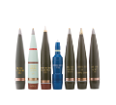
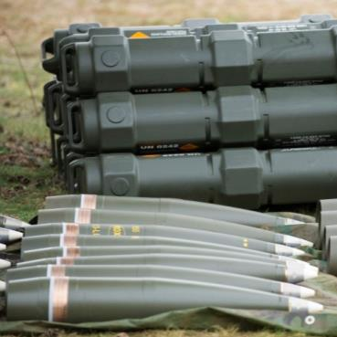
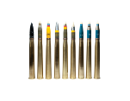
AMMUNITION PRODUCTS PORTFOLIO
LAND AMMUNITION
Artillery
Tank
Mortar
Medium-caliber
NAVAL AMMUNITION
Artillery
Medium-caliber
AIR AMMUNITION
This document is the property of Nexter. The information it contains cannot be used, reproduced or disclosed without prior written approval from the issuing authority.
Medium-caliber
Powders and explosives
PROTECTION
COMPONENTS
Fuses
Detonators

Slide 12
NEXTER SYSTEMS
13 route de la Minière
78034 Versailles Cedex FRANCE
Tel: +33 (0)1 39 49 30 00
Fax: +33 (1) 30 97 39 00
Web: www.knds.com

