Slide 1
LTG Infra
Rail Baltica implementation

Slide 2
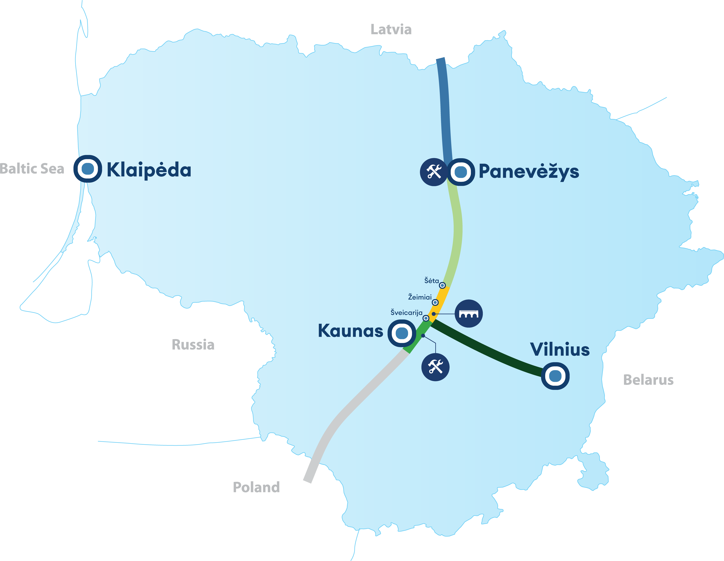
Status
Šveicarija-Žeimiai-Šėta
Construction of railway embankment, engineering structures and roads in progress
Panevėžys-LT/LV border
New procurement for design&build services will be launched
Kaunas-Vilnius
Territorial planning service in process, land acquisition contracts have been signed, procurement of design services in progress
Kaunas-LT/PL border
Territorial planning in final stage, land acquisition procedures have been started, procurement of design services in progress
Kaunas Urban Node
Territorial planning finished, land acquisition procedures have been started, procurement of design services in progress

Slide 3
Priorities
Mainline construction
Project acceleration
Notes:
With regards to our focus, as the project in Lithuania is getting more and more mature, currently we have 2 major goals and I firmly believe it will be so for the time to come:
1. First one is to connect PL and LV borders, which means that we are putting our emphasis on the core connection that is to say construction of the mainline;
2. The second one is, that we are in constant search for solutions how we could speed up the overall implementation of the project and possibly achieve active operations of particular sections even before official deadline of the project, which is 2030. For this purpose, we are expanding our project activities, as for example, in a few sections we are up to start construction of the point type objects (bridges, various passes, viaducts) prior the construction of actual embankment. Moreover, we are always aiming to execute multiple inner and outer project implementations processes in parallel, as for example land acquisition and design services activities;
3. Of course all of this wouldn’t be possible without professional team and consolidated resources, which refers to fact that we have strengthened our project implementation capacities substantially this year and are up to expand our team in the same manner next year;
4. And last, but not the least, is proactive communication with the market, our existing and feasible future contractors and service providers as locally, as internationally.

Slide 4
Construction procurement
Construction of a new railway embankment and structures
Ongoing procurement
DS1 DPS1 Kaunas – Šveicarija 0.50 – 19.4 km (18.9 km). Planned proposal submission date - 2024-08.
DS1 DPS4 Šėta – Ramygala 48,8 – 65,9 km (17.1 km). Planned proposal submission date – 2024-07.
Upcoming procurement
DS1 DPS4 Šėta – Ramygala 65.9 - 78 km (12.1 km). Planned announcement date - 2024-06
DS2 DPS1 Ramygala-Berčiūnai 78-102.45 km (24.5 km). Planned announcement date - 2024-09
DS2 DPS2A Berčiūnai-Joniškėlis 102.45-114.8 km (12.4 km). Planned announcement date - 2024-09
Construction of railway track superstructure
Upcoming procurement
- Section Kaunas – Panevėžys - LT/LV state border (168 km). Planned announcement date - 2024-06

Slide 5
Design & build procurement
Upcoming procurement
Kaunas node section
Point type objects (7 units - briges, viaducts, tunnels.). Planned announcement date – 2024-06.
Section Panevėžys – LT/LV border
DS2 DPS2B-DPS4 Panevėžys and the LT/LV border 114.8-168.6 km (53.8 km.). Planned announcement date - 2024-09.

Slide 6
Design procurement
Upcoming Procurements
Section Kaunas – LT/LV border
Design service for the construction of the new railway infrastructure in Panevėžys node. Planned announcement date 2024-09.
Design service for the construction of regional connections and regional stations in section from Kaunas Urban Node - LT/LV state border. Planned announcement date 2024-09.
Design service for Panevėžys IMF. Planned announcement date 2024-08.
Design service for Kaunas IMF. Planned announcement date 2024-08.
Section Kaunas – Vilnius
Design service for Vilnius – Kaunas Regional Stations (Vievis). Planned announcement date 2024-09.
Design supervision service for Vilnius – Kaunas Regional Stations (Kaišiadorys). Planned announcement date 2024-09.
Design service for Vilnius node. Planned announcement date 2024-09.

