Slide 1
CEO - Vladimir Galperin

Slide 3
Logistics services
Warehousing facilities
Services of a personal sales manager
Certification & Legal assistance
Support of export and import

Slide 4
AGRICULTURAL PRODUCTS
NUTS & DRIED FRUITS
SPICES
MINERAL FERTILIZERS
TEXTILES
NITRILE GLOVES
CERAMICS
CAST IRON PRODUCTS
ALCOHOL

Slide 5
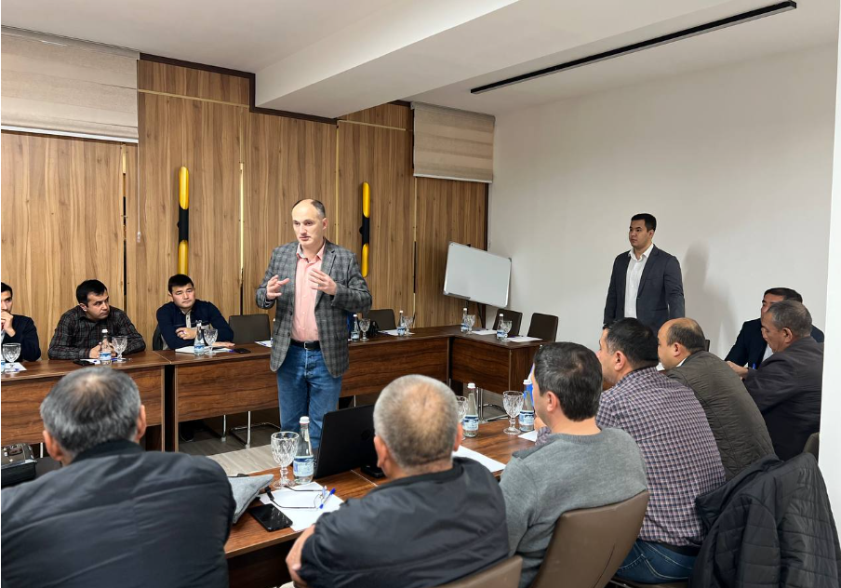
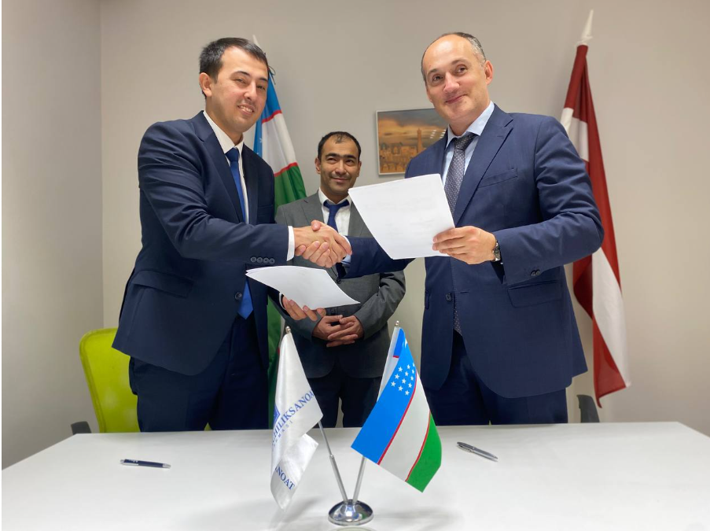
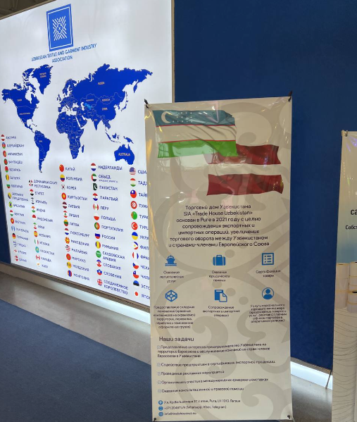

Slide 6
LATVIA
SWEDEN
ROMANIA
GERMANY
NORWAY
UKRAINE
BULGARI
MOLDOVA
FINLAND

Slide 7
Thank you for attention!
CONTACT US
Kr. Valdemara str.37, Riga
+371 20313141
info@tradehouseuz.eu
www.tradehouseuz.eu

