Slide 1
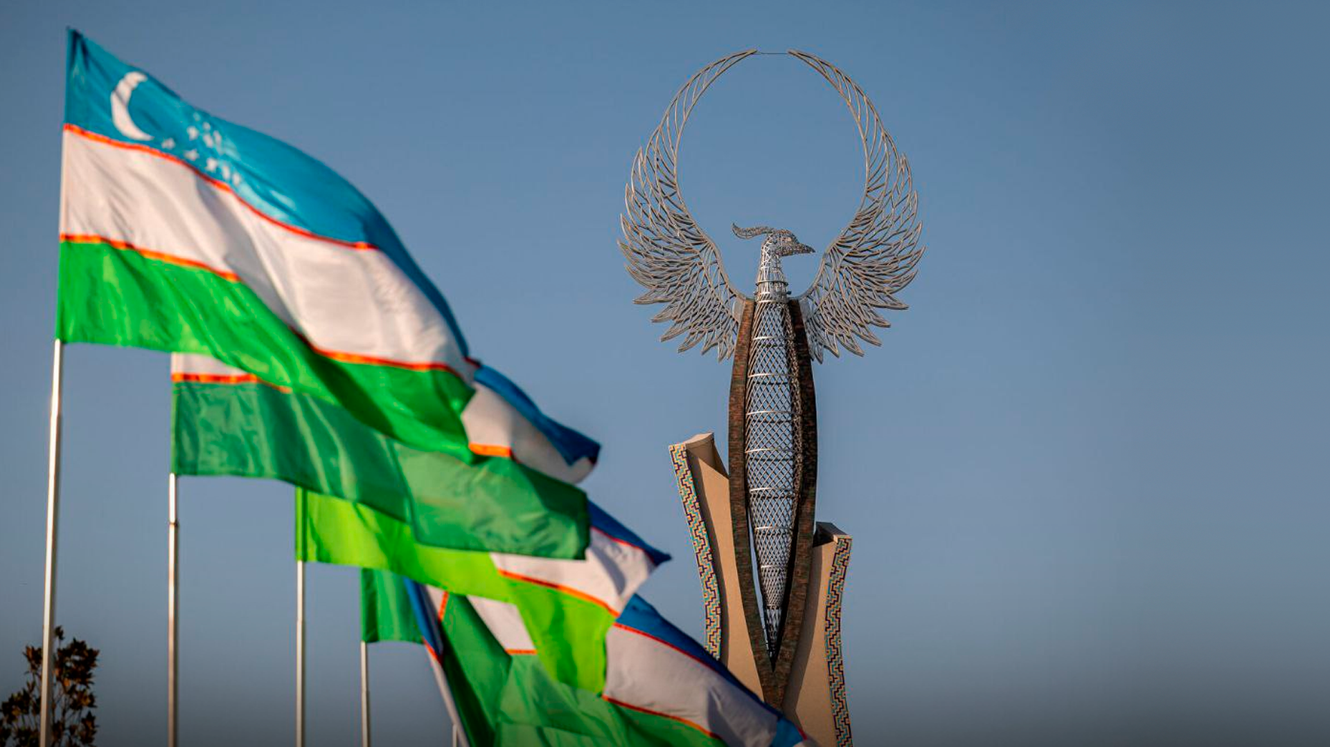
Ministry of Investment, Industry and Trade of the Republic of Uzbekistan
INVEST IN UZBEKISTAN

Slide 2
KEY DATA
448,9K km
11
Area
International Airports
A strategic position in the middle of Central Asia with the population over 78 mln
36,8 Mln
~50%
East Asia +Southern Europe
Population
Urbanization rate
Through China, Kyrgyzstan and Uzbekistan

Slide 3
ECONOMIC GROWTH
GDP, CURRENT BLN USD
ECONOMIC GROWTH RATE, %
62,1
90,8
Increased 1,5 times
4,5
6,0
Increased 1,3 times
2017
2023
2017
2023
INDUSTRIAL PRODUCTION, BLN USD
INFLATION RATE, %
28,9
55,9
14,4
8,8
Increased 1,9 times
Decreased 1,6 times
2017
2023
2017
2023

Slide 4
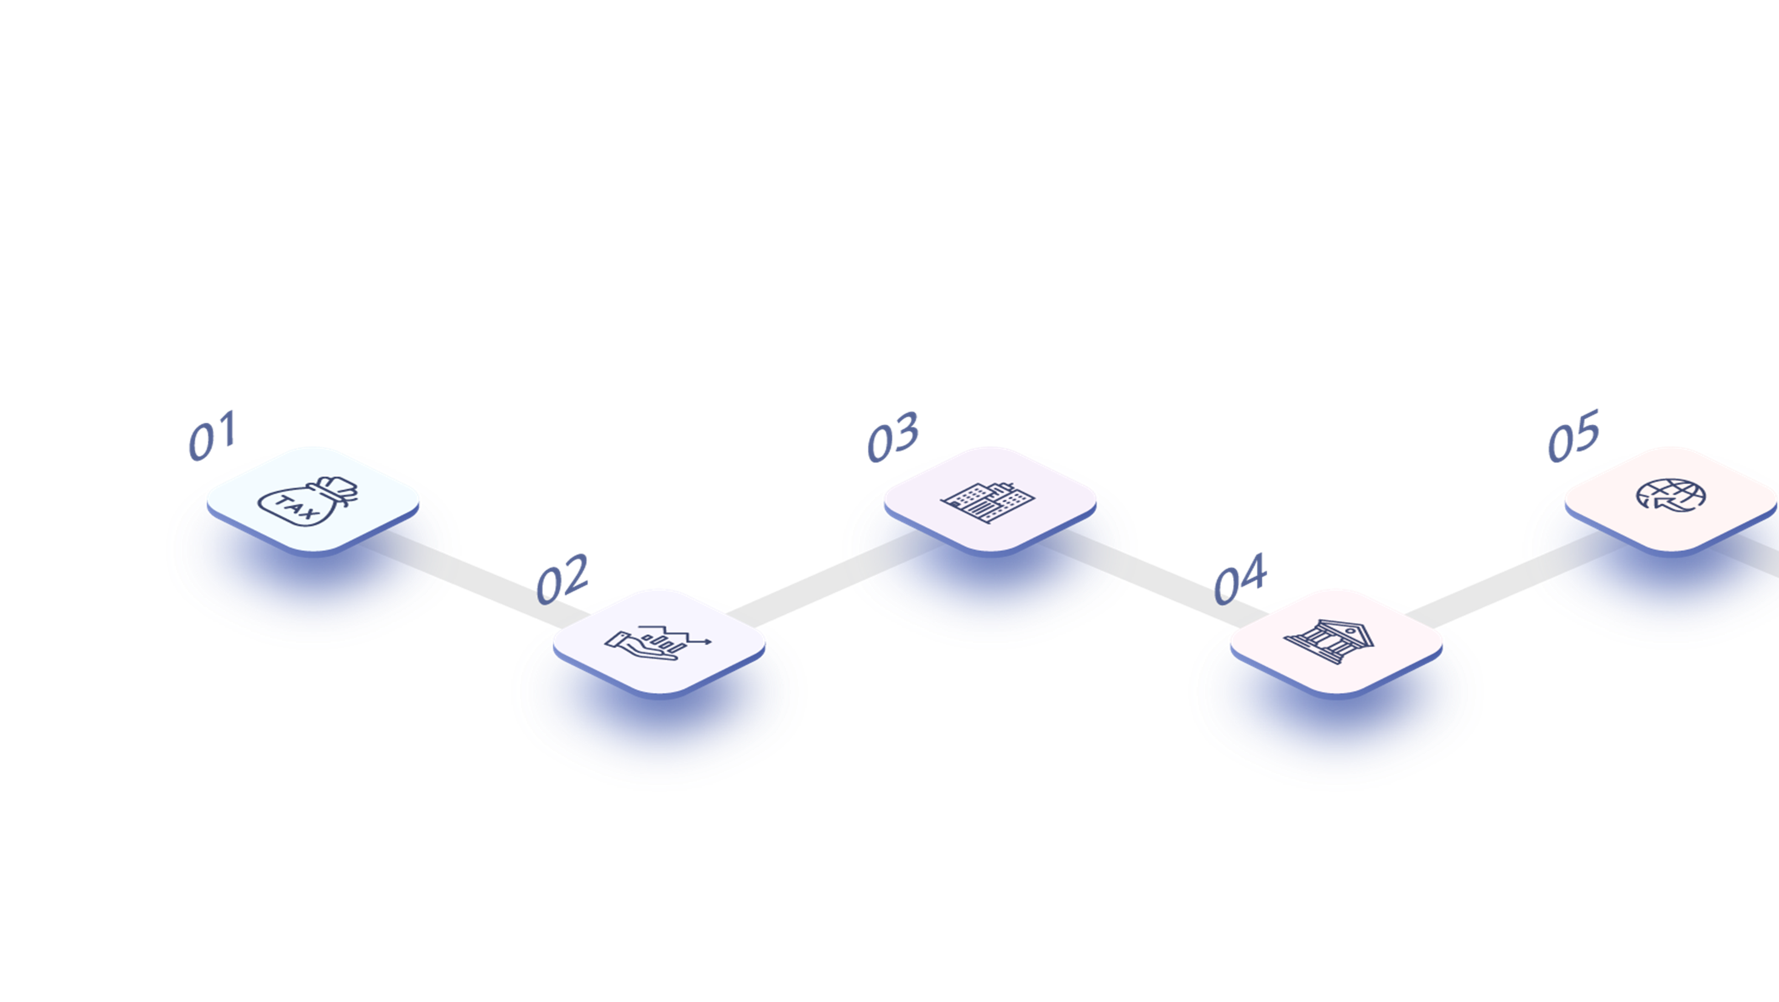
REFORMS OF PAST 7 YEARS
Foreign Investors Council under the President was established
500 functions of the Government on regulation of business were removed
VAT rate was reduced from 20 % to 12 %
The number of government services on the
“Single window” increased
from 96 to 400.
132 licenses and permits were abolished
REGULATION
TAX REFORM
PRIVATIZATION PROGRAMM
ADMINISTRATIVE PROCEDURE
ECONOMIC LIBERALIZATION
- adoption new Law On investment
- achieving one of the most liberal levels of tax policy in the region
- government assets worth more than $1,0 bln have been sold
- the number of countries with a visa-free regime
increased from 9 to 93
- liberalization of the foreign exchange market
- ensuring the protection of rights of investors
- adoption new Tax Code
- simplification registration procedure of legal entities
- customs duties on all exported goods and services were abolished
- adoption Law On Public-Private Partnership
- improving the court system
- applying declarative approach

Slide 5
Bringing GDP to $160 billion and per capita income to $4 thousand.
Attracting of $250 bln investment in the country
Ensuring the growth of the volume of investments annually invested in fixed assets by an average of 7 percent.
Ensuring an annual inflation rate of 5-6 percent
“UZBEKISTAN – 2030”
STRATEGY
Bringing the volume of the freely traded securities market to $8 billion.
Implementation of more than 500 strategically significant technological and infrastructure projects

Slide 6
“UZBEKISTAN – 2030”
STRATEGY
ENERGY SECTOR
ELECTROTECHNICAL INDUSTRY
- bringing renewable energy sources to 25 GW and their share in total consumption to 40%
- modernization of electricity and natural gas distribution, generation and delivery infrastructure
- digitalization of metering of all types of energy resources
- increasing copper throughput by 300К tons
- attracting investments of $1,5 bln to localization production of all household appliances
- establishment of a research and production cluster and R&D centers
BUILDING MATERIALS
TEXTILE INDUSTRY
- to double the volume of production from $2,9 bln to $6 bln
- attracting $6 bln of investment in new projects to widen the product range of the building materials industry
- expanding the production of new types of energy efficient materials
- supply of export products to the European market worth $500 mln using existing GSP+ preferences
- production of 400K tons of synthetic and blended fibers
AUTOMOTIVE SECTOR
AGRICULTURE
- create a competitive environment and increase production volume to 1 mln units
- localization of passenger cars, agricultural machinery and automotive components and spare parts up to 60%
- attracting $15 bln. of investment
- ensuring the degree of processing of agricultural products above 25%
- increasing export to $10 bln a year

Slide 7
FDI LANDSCAPE
FDI* SECTORAL STRUCTURE IN 2017 – 2023
FDI INFLOWS IN 2017 – 2023, MLN USD
Manufacturing
18,1 %
Energy supply
Information
and communication
3,6 %
$55,3 bln
36,3 %
Mining
12,6%
Transportation
1,8%
10,5%
Other
* FDI in fixed assets

Slide 8
Developing Infrastructure and abundant natural resources
Competitive business costs, incentives and comfortable living conditions
5
Reasons to invest in Uzbekistan
Irreversible reforms and strategic development
Accessibility of local
and regional markets
Competitive
human capital

Slide 9
COMPETITIVE HUMAN CAPITAL
ENROLMENT RATE
INTERNATIONAL
UNIVERSITIES
Pre-school
70%
209 higher educational institutions (HEIs)
School
100%
More than 1 mln students are studying in HEIs
Higher
38%

Slide 10
WELL-DEVELOPED INFRASTRUCTURE AND ABOUNDANT RESOURCES
WELL-DEVELOPED INFRASTRUCTURE
NATURAL RESOURCES
Resources | Rank in the world | Proven reserves
Gold | 10 | 184 mln oz
Natural Gas | 19 | 1,87 trln m
Copper | 10 | 44,7 mln t
Uranium | 16 | 139,2 thous. t
13,7K km
184K km
Total length of
gas pipelines
Total length
of roads
3
4,7K km
270K km
Total length of
railway system
Total length of
power lines

Slide 11
ACCESSIBLE MARKETS
GSP+ Enhanced Framework
Since 2022 Uzbek producers could export to the EU about 3,000 goods without charging customs duties and 3,200 items – at reduced rates.
448
Million in EU
300
783
MILLION
Million in CIS
CONSUMERS
In 2022, Uzbekistan, increased exports to the EU by 4 times — up to €450 mln., and trade turnover between Uzbekistan and the EU increased by 30% in 2023.
78
Million Central Asia
countries

Slide 12
COMPETITIVE BUSINESS COSTS
INDICATOR
PRICE
TAXATION
RATE
Electricity, $ per 1 kWh
0,07
Personal income tax
12%(flat)
Drinking Water* $ per m³
0,06 to 0,61
Tax on profit
15%
Sewerage*, $ per m³
0,03 to 0,57
Natural gas, $ per m³
Value
added tax
0,12
12%
Wage, $
387,8
*Drinking water and sewerage price depends on region

Slide 13
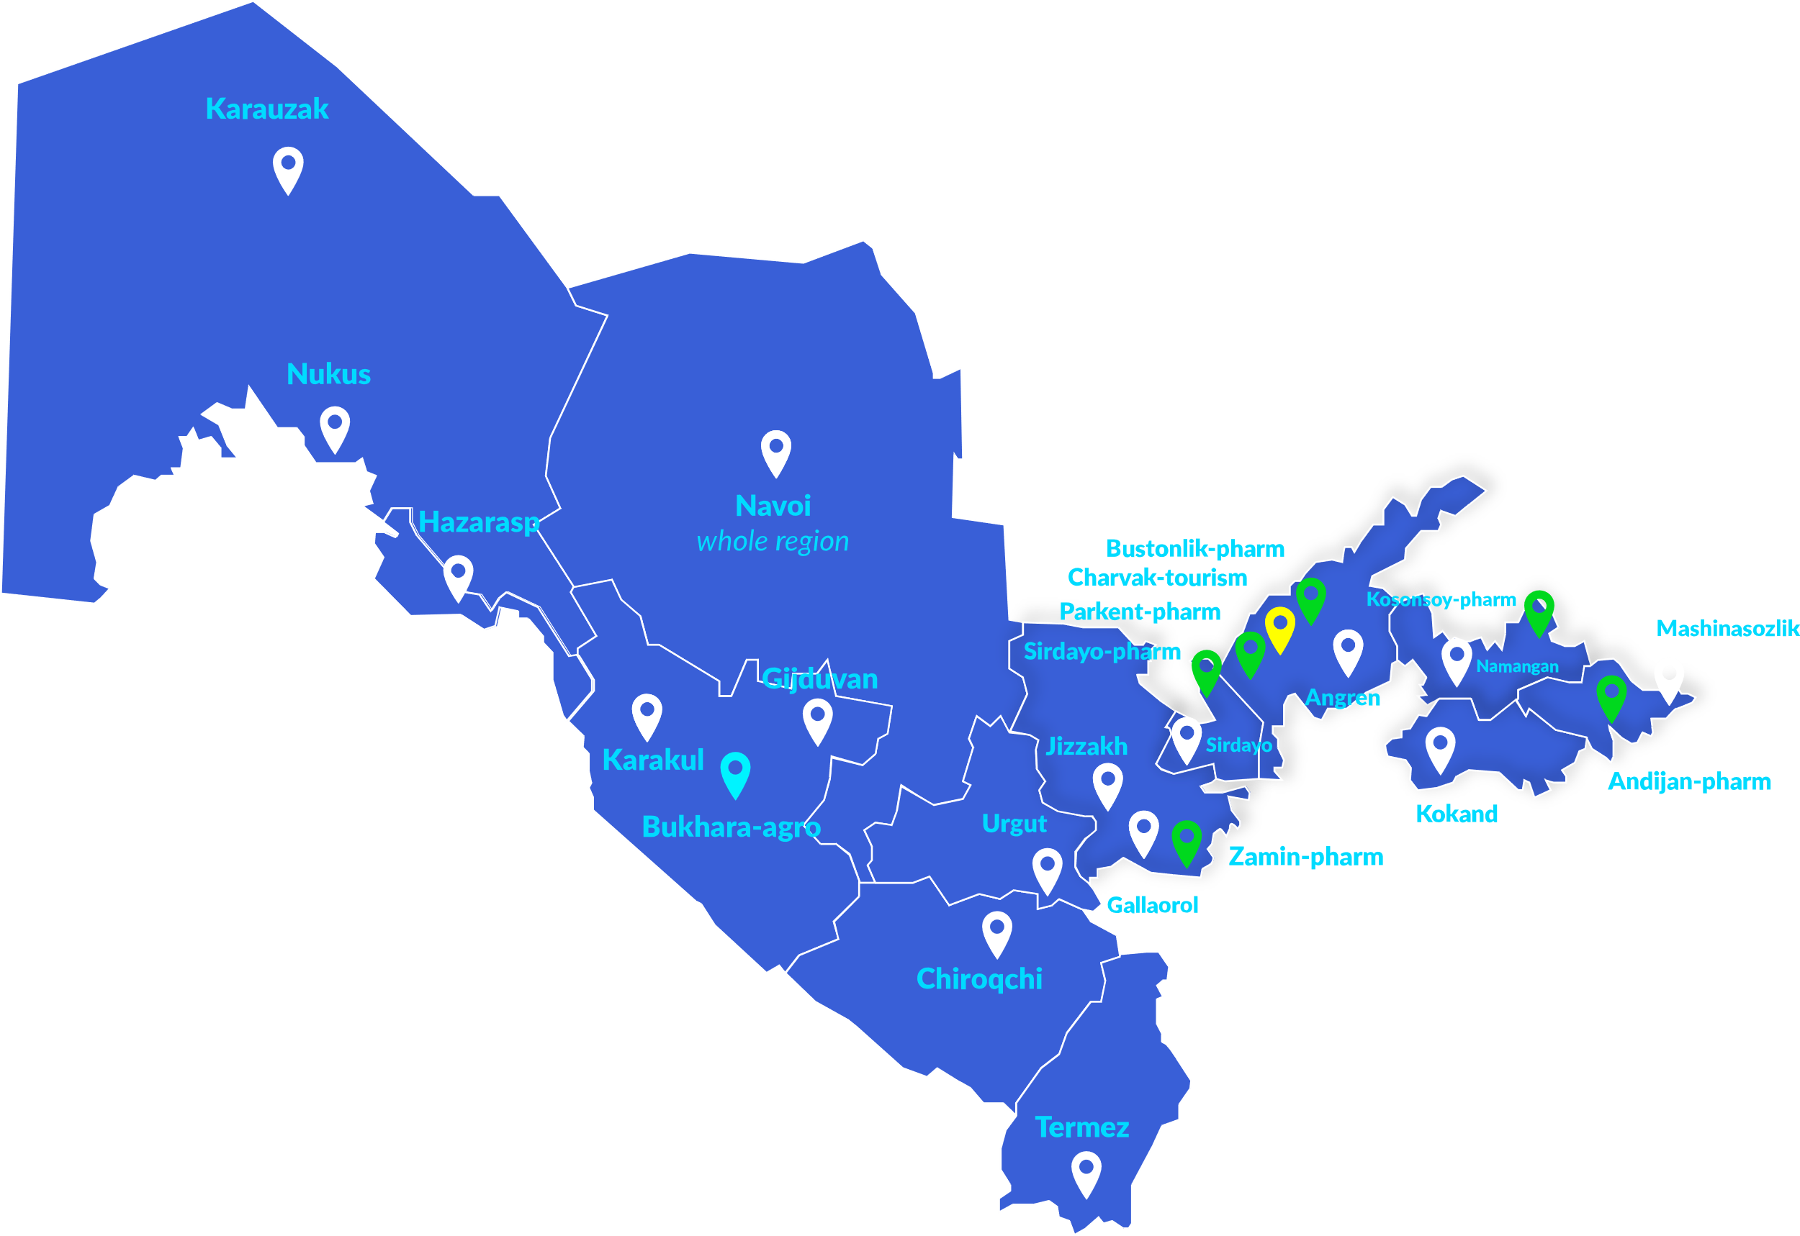
INCENTIVES FOR INVESTORS
ENTERPRISES WITH FDI* ARE EXEMPT FROM PAYING
TAX EXEMPTIONS FOR SEZ ENTERPRISES
Tax on property
Water usage tax
Land tax
Tourism FEZ
Tax on profit
Pharmaceutical FEZ
Agricultural FEZ
Industrial FEZ
5 years for investment of $3M – $5M
3 years for investment of $0,3M – $3M
5 years for investment of $3M – $10M
7 years for investment of $10M+
7 years for investment of $5M – $15M
*Except Tashkent and Tashkent region
10 years for investment above $15M
Not less than 15% should be the share of foreign investors in JSC and at least 33% in other cases.
tax on property
water usage tax
land tax
The property imported for personal use by foreign investors and their foreign employees residing in the Republic of Uzbekistan is not subject to customs duty.
Customs duty exemption
3 years for investment of $0,3M – $3M
5 years for investment of $3M – $5M
7 years for investment of $5M – $10M
10 years for investment above $10M

Slide 14
COMFORTABLE LIVING CONDITIONS
Gastronomic, cultural and sport tourism for appropriate price
A single person estimated monthly costs are $424,1
Investment visa option for you and family members
Family of four estimated monthly costs are
$1507,2
90+ countries with
visa-free regime

Slide 15
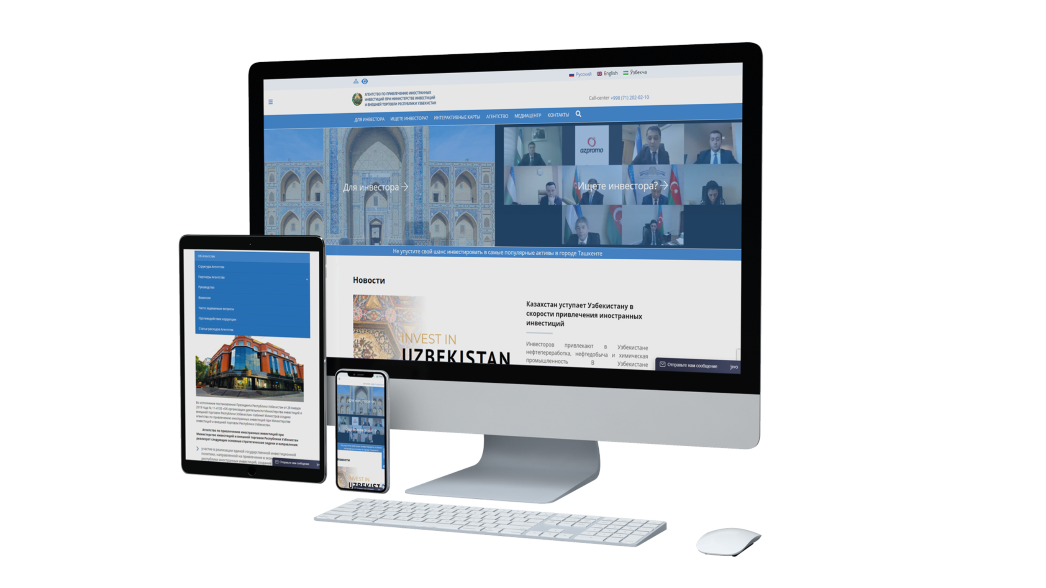
INVEST IN
UZBEKISTAN
+998 71 202 02 10
www.invest.gov.uz
uzipa@invest.gov.uz
13 Amir Temur Avenue, 100000, Tashkent, Republic of Uzbekistan

